Slide 1
FEM2401 Malaysian Politics and Society TOPIC 2: INDEPENDENCE OF MALAYSIA
By:
MUHAMMAD AMIR BIN MUNSHI

Slide 2
Lesson 2: Chapter 1.2: From Colonialism to Independence
Contents:
Colonial rule
Nationalist movements
The formation of Malaysia

Slide 3
THE STAGES OF MALAYSIAN HISTORY

Slide 4
Colonial Powers in Malaysia
Portuguese, 1511-1641
Dutch, 1641-1824
Siamese, 1821-1842
British, 1786-1957
Japanese, 1941-1945

Slide 5

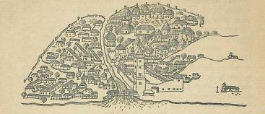
Portuguese, 1511-1641
In August 1511, Malacca fell to the Portuguese.
The Portuguese period focused in Malacca, and they faced strong competition with the kingdom of Johor (successor of Malacca), and Aceh (the great Malay kingdom based in the north of Sumatra)
Portuguese Malacca was under a Captain (Kapitan), answering to the Viceroy in Goa, India.
Great impacts on social-cultural and religion (Christianity)
Legacy of occupation: the Portuguese Eurasian community (Kristang), and Portuguese loan-words in Malay: jendela, almari, garfu, bola
An illustration of Portuguese Malacca in the 16th century

Slide 6

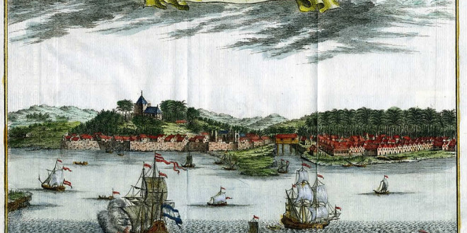
Dutch, 1641-1824
In 1641, with the help of Johor, the Dutch succeeded in driving the Portuguese out of Malacca and took over
Monopolised the tin trade in Malay states such as Riau, Perak, and Selangor
In the 17th century, attempted to expand their power in Perak, but failed
In 1784, occupied Kota Melawati in Kuala Selangor, but the Sultan Ibrahim of Selangor retook the fort a year later
An illustration of the Dutch in Malacca

Slide 7

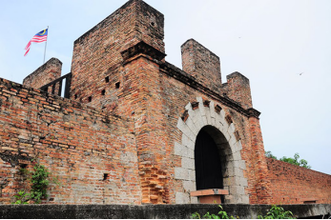
Siamese, 1821-1842
The northern Malay states of Kedah, Patani, Kelantan, and Terengganu, recognised Siamese overlordship, and paid tribute in golden and silver trees once every three years
In November 1821, the Siamese occupied and directly ruled Kedah (in Siamese: Saiburi)
Wars of northern independence 1821-1842
In 1842, Siam retreated from Kedah, and returned the throne to the exiled Kedah Sultan
Anglo-Siamese Treaty 1909, Siam agreed to transfer rule of Kedah, Perlis, Kelantan, and Terengganu to the British
Kuala Kedah Fort, occupied by the Siamese 1821-1842

Slide 8

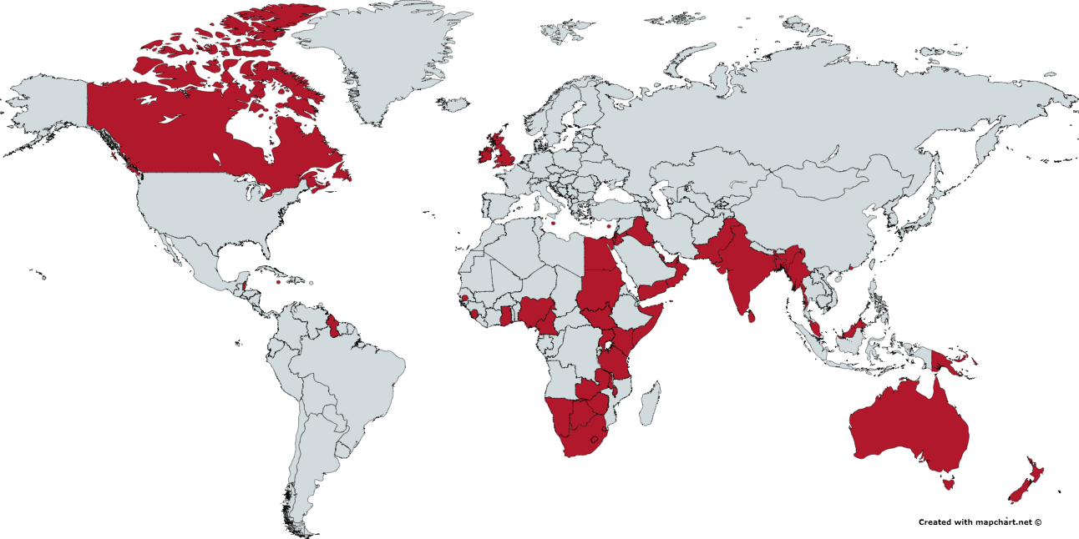
British, 1786-1963
The British empire expanded into Malaysia from the 18th to the 20th centuries
British colonialism happened gradually, and administrative systems were different between regions
Has a significant influence on systems of government and administration, ethnic demography, economic structure, language, education, and so on.
The most significant colonization period for Malaysia
Change of British policy from non-intervention to intervention in 1874 – driven by economic motive (to protect their economic interest)
A map of the British Empire, including Malaysia

Slide 9
TREATY OF LONDON 1824
The treaty ended the competition between Great Britain and the Netherlands - in London on 17 March 1824.
The treaty (also known Anglo-Dutch treaty or British-Dutch Treaty) important to resolve trade/economic dispute Great Britain and the Netherlands in Southeast Asia since the 17th century.
It redefined the spheres of influence of the colonial power of British and Dutch in the region, also eventually leading to the formation of British Malaya and the Dutch East Indies.
Dividing the region/Malays land/island - Malacca to British and Bangkulen (Indonesia) to Dutch - British had their to formally “control” Malaya.
The treaty also set today geographical boundaries between Malaysia (and Singapore) and Indonesia.

Slide 10
Straits Settlements
In 1786, following the treaty between Kedah and the East India Company, Francis Light raised the Union Jack flag in Penang Island
In 1800, Prai (later renamed Province Wellesley) taken over by British
In 1819, Stamford Raffles, a clerk for the EIC, became the mediator between two claimants to the throne of Johor. The British were allowed to set up a trading post in Singapore.
In 1824, the Anglo-Dutch Treaty. The British took over Malacca from the Dutch.
In 1867, these Straits Settlements became British Crown Colonies

Slide 11

Federated Malay States (FMS)
British direct involvement in the Malay States began in 1874. The British placed a resident in Perak (J.W.W. Birch, 1874), Selangor (J.G. Davidson, 1874), Pahang (J.P. Rodger, 1888), and Negeri Sembilan (Martin Lister, 1889).
Residential system (1874 – 1895) ➔ Pangkor Agreement 1874
Official intervention of British into the state administration / indirect rule
The result of agreement between British and Sultan Abdullah (of Perak) regarding the throne dispute
On 1 July 1896, these states were federated into the FMS, led by a Resident-General (Frank Swettenham), its capital in Kuala Lumpur. This federated system was implemented to streamline the administrative system in these states
In the 1920s, decentralization was introduced due to concerns of over-centralization of power to KL, and to return powers to the state governments

Slide 12
Unfederated Malay States (UMS)
Consists of states not part of the FMS. These states were British protectorates, but received British Advisors instead of residents, and most state administration was run by British-educated Malay elites
Anglo-Siamese Treaty of 1909 placed the states of Kedah, Perlis, Kelantan, and Terengganu under British protection
In 1914, Johor agreed to accept a British Advisor

Slide 13
The British in Sarawak
In 1841, James Brooke, a British adventurer, aided the Raja Muda Hashim to quell a rebellion in Sarawak. He was appointed as Raja or governor of Sarawak. This began the age of the White Rajahs of Sarawak (1841-1946)
These White Rajahs were James Brooke (1841-1868), Charles Brooke (1868-1917), and Charles Vyner Brooke (1917-1946)
In 1946, Charles Vyner Brooke ceded Sarawak to the British, which now became a British Crown Colony

Slide 14
The British in Sabah
In 1881, The British North Borneo Chartered Company was established to administer Sabah
W.H. Treacher was appointed first Governor of North Borneo
In 1888, North Borneo became a British protectorate
BNBCC administration extended to Labuan island in 1890
BNBCC administration continued until WWII, when Sabah was occupied by the Japanese
In 1946, North Borneo became a British Crown Colony

Slide 15
NASIONALISM
Loyalty and devotion to a nation especially a sense of national consciousness exalting one nation above all others and placing primary emphasis on promotion of its culture, identity and interests as opposed to those of other nations or supranational groups
The process involves:
The attitude that the members of a nation have when they care about their national identity
The actions that the members of a nation take when seeking to achieve (or sustain) self-determination.

Slide 16
NATIONALIST MOVEMENT IN MALAYA
Focus on the era of British colonial
1821-1942: Two phases of nationalist movement
Before 20th century/Before the World War 1- physical struggle.resistance
After World War 1 – diplomatic approach or non-physical resistance
Before 20th century :
Method: Armed/physical aggression and violence
Nationalists: Malay Rulers, local dignitaries, chief/leader of community, head of religious groups (led by people who held a position in the society)
After 20th century:
Method: Diplomatic approach (writing, media, arts and literature)
Nationalists: Educated groups, religious groups, journalists, writers, members of the public

Slide 17
THE IMPACT OF BRITISH ADMINISTRATION BEFORE FIRST WORLD WAR
Local leaders and rulers lost their traditional position
Local people suffered – high taxes
Local resources were exploited
British introduced:
Unsuitable policy with the local
Abolished traditional practices/customs (such as head hunting, slavery, etc)

Slide 18
Wars and uprisings against the British
Event | Area | Year
Kedah-EIC war | Kedah-Penang | 1791
Dol Said resistance | Naning | 1831-1834
Liu Shan Bang uprising | Sarawak | 1857
Rentap campaigns | Sarawak | 1844-1861
Sharif Masahor uprising | Sarawak | 1859-1860
Banting uprising | Sarawak | 1893-1908
Penghulu Asun uprising | Sarawak | 1931-1932

Slide 19
Wars and Uprisings against the British (II)
Event | Location | Year
Perak War | Perak | 1875-1876
Pahang War | Pahang | 1891-1895
Tok Janggut uprising | Kelantan | 1915
Abdul Rahman Limbong rebellion | Terengganu | 1928
Sepoy Mutiny | Singapore | 1915
Mat Salleh uprising | Sabah | 1894-1900
Rundum rebellion | Sabah | 1915

Slide 20
THE CHANGES AFTER 19TH CENTURY
The development of education system (including British school)
More local people were educated
The spread of nationalism and struggle for independence from abroad
Intellectuals groups played an important role in stimulating the spirit of nationalism
Malay nationalism was propagated by three main groups of intellectuals
Arab-educated Malays (Islamic reformist)
Malay educated (the left)
English educated (Traditional elite)

Slide 21
FACTORS INFLUENCING MALAY NATIONALISM AFTER 19TH CENTURY
EXTERNAL FACTORS
Russia-Japan War (1904-1905)
The victory of Japan gave confidence to Asians
The struggle of Indonesians in fighting the Dutch
The struggle inspired the Malays
Pan Islamism in the Middle East influenced the Malays (among the Arab-educated)
Turkish Youth Movement
Islamic reform (Al Islah movement) in Egypt
led to the formation of Islamic reformist movement (Youth group)

Slide 22

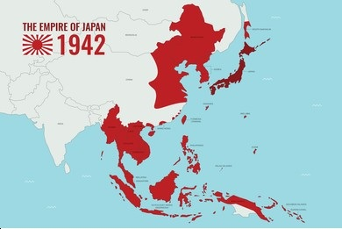
Japanese, 1941-1945
The expansionist campaign of the Japanese Empire to Malaysia began during the Second World War. On 8 December 1941, the Japanese landed in Kelantan, on the east coast of Malaya. Later that same month, the Japanese landed in Miri, Sarawak
By 31 January 1942, the Japanese arrived in Johor and has overrun Malaya
On 15 February 1942, Singapore fell to the Japanese
By February 1942, all of Borneo Island fell to the Japanese
Japanese rule ended in August 1945
Japanese Empire in 1942, including Malaysia

Slide 23
The Road to Independence
Malayan Union, 1946-1948
Movements in Sabah and Sarawak
Emergency 1948-1960
Political Cooperation and the Alliance, 1951-1955
Towards Independence, 1956-1957

Slide 24
Malayan Union, 1946-1948
A new administration system introduced to replace the various systems of government in Malaya at the time (Straits Settlements, FMS, UMS)
Preparation for self government
Approved by Parliament on 10 October 1945
In October 1945, Sir Harold MacMichael, who served in Sudan and the Palestinian Mandate, was appointed by the British to obtain the signatures of the Nine Malay Rulers

Slide 25
Main conditions of the Malayan Union
All nine Malay states and two states of Straits Settlement (except Singapore) were under the British Governor
The position of Sultan remained but the power was confined to the matters of Islam and Malay customs only
The State Executive council were retained for the purpose of managing local government only
Citizenship: Equal rights to all races including immigrants (jus soli principle)

Slide 26
Opposition to the Malayan Union
The Malayan Union received widespread opposition from the Malays for a number of factors:
(a) Abolishment of the Sultan’s sovereignty
(b) Granting of citizenship on jus soli principle – reducing status of natives
(c) MacMichael’s harsh methods to obtain signatures of the Malay Rulers
The opposition mostly came from the Malays -protests and demonstration throughout the states. Boycott and performed marches to show their disagreement
Due to the strong opposition, finally Malayan Union was failed to implement

Slide 27
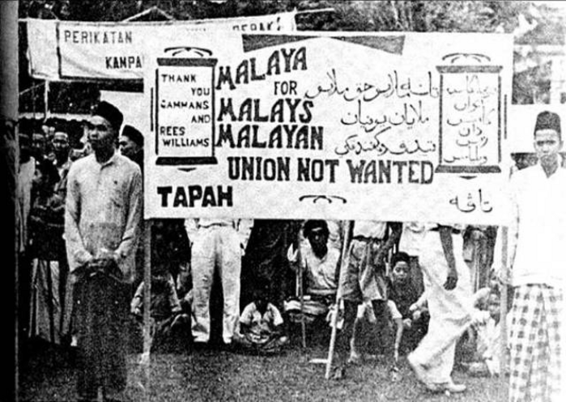
Protest by Malays against the Malayan Union in Kuala Kangsar, Perak

Slide 28


Formation of UMNO
During the Second Malay Congress in Johor Bahru on 11-12 May 1946, the United Malays National Organisation (UMNO) was formed
Dato’ Onn bin Jaafar was chosen as the party’s first President
For the first time, the political voice of the Malays was united under one party that received widespread support from all sections of society: aristocrats, leftists, Muslims religious figures, civil servants, women ,journalists, and teachers
However, later, due to ideological differences, some elements such as the left and the religious left UMNO and formed their own parties
Image of Dato’ Onn bin Jaafar
First President of UMNO 1946-1951

Slide 29
Federation of Malaya 1948
New British plan to replace Malayan Union
Government structure:
High Commissioner was the highest executive body
The rights, power and sovereignty of the Malay Rulers were restored
A conference (council) of Malay Rulers was established to offer advice to the High Commissioner
Citizenship: Stricter conditions were applied. The Malays were given special position as indigenous people
More acceptable, minor opposition
Opposed by left ideological groups such as Malayan Communist Party (PKM) and Young Malay Union (KMM)

Slide 30
Political Development in Sabah and Sarawak
After the Japanese surrender, the British North Borneo company handed over rule of North Borneo to the British, and Sabah became a British Crown Colony on 15 July 1946
In Sarawak, the White Rajah Charles Vyner Brooke handed over Sarawak to the British government, and Sarawak became a British Crown Colony
Beginning of the anti-cession movement in Sarawak by the Sarawak Malays – murder of Governor Duncan Stewart
The anti-cession movement faltered in 1950.

Slide 31
POLITICAL PARTIES
Few political parties were formed during the process of independence – significant contribution to the effort in gaining independence for Malaya
Malayan Communist Party, 1930
Young Malays Union (KMM), 1938
United Malays National Organisation (UMNO), 1946 (reacted to Malayan Union 1946)
Malayan (now Malaysian) Chinese Association (MCA), 1949
Malaysian Indian Congress (MIC), 1949
Pan-Malayan (now Malaysian) Islamic Party (PAS), 1951

Slide 32
FEDERATION OF MALAYA 1957
Few steps/plans in preparing Malayan to independence
Member system 1951 (similar to cabinet system)
Local government elections, 1951-52
Federal election, 1955 (electing representatives to lead the new country)
Merdeka mission, 1956
The formation the Independence Constitution by Reid Commission, 1957
In 1955, UMNO and MCA, and later MIC (Malayan Indian Congress – formed 1946) later formed the Alliance. This is significant, as it marked the cooperation of three of the largest ethnicities in Malaya through political cooperation.

Slide 33
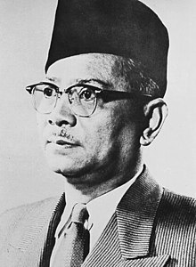
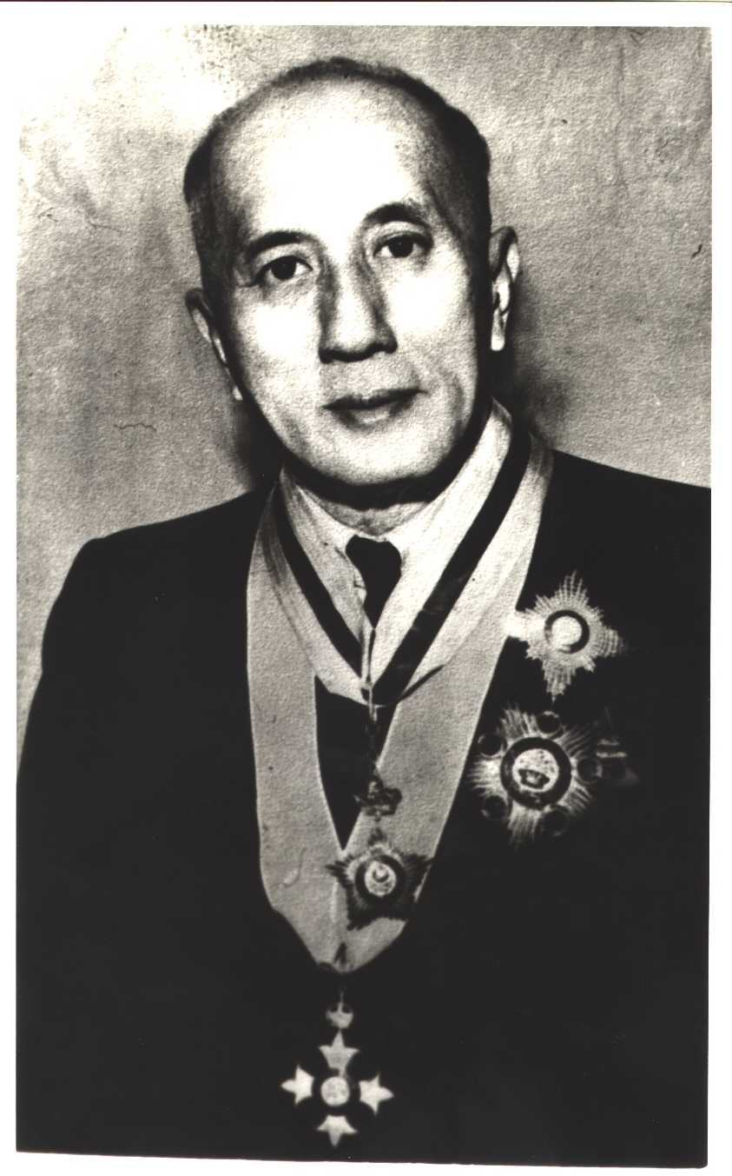
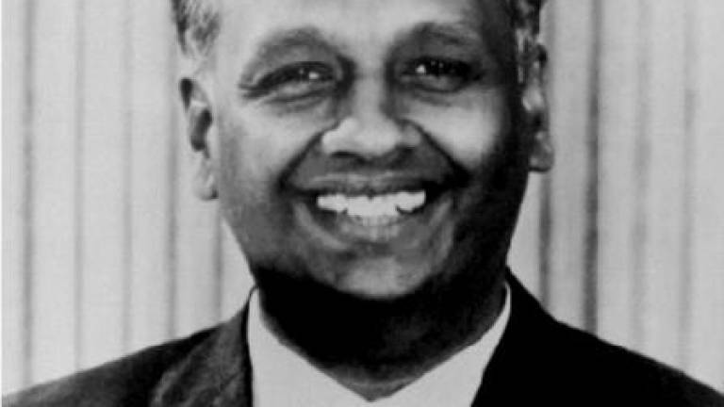
Leaders of the Alliance
Tunku Abdul Rahman,
UMNO
Tan Cheng Lock, MCA
VT Sambanthan, MIC

Slide 34
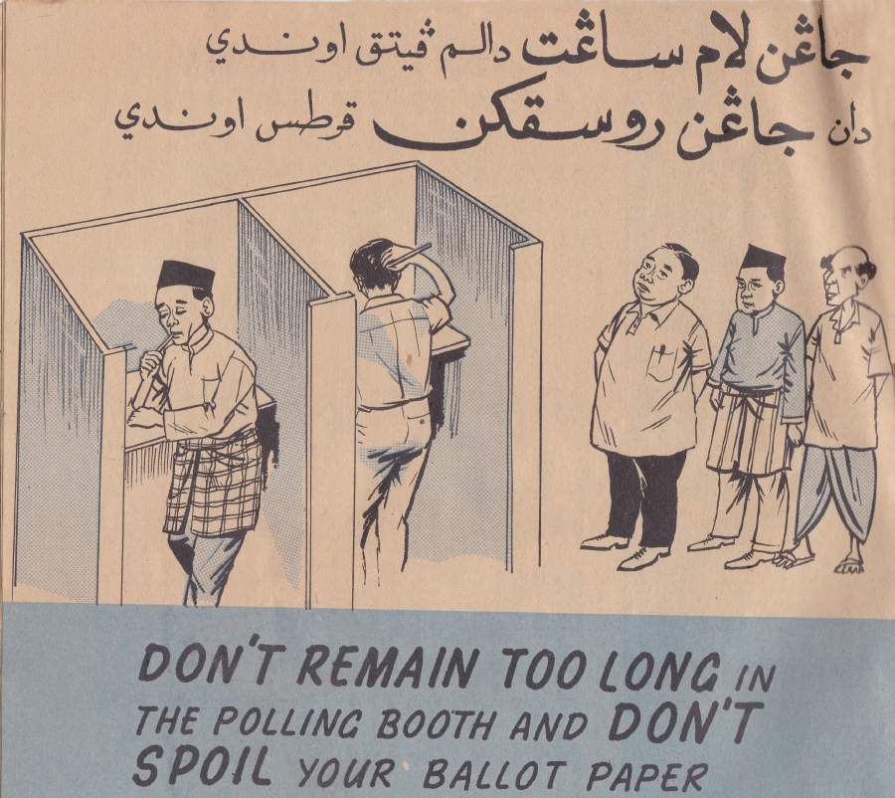
First General Elections, 1955
The first General Elections in Malaya was held on 27 July 1955
52 seats were contested
The Alliance won 51 out of 52 seats
With this victory, the Alliance could form a self-government, and worked towards full independence for Malaya

Slide 35
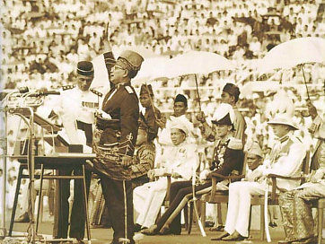
Towards Independence, 1955-1957
1955 – Tunku Abdul Rahman became first Chief Minister of Malaya after the 1955 elections. Baling Talks with the MCP in December fails.
1956 –Independence Talks in London between January and February 1956. Reid Commission established to draft a new Constitution for independent Malaya
1957 – 31 August, the Federation of Malaya became independent

Slide 36

Formation of Malaysia
Idea of Malaysia
Reaction to the Idea of Malaysia
Rationale for Forming Malaysia
Steps towards Formation
Formation of Malaysia 1963
Singapore’s exit from Malaysia 1965

Slide 37
CHRONOLOGY OF THE IMPORTANT EVENTS
The merger of Malaya with neighboring countries to be a Federation of Malaysia – proposal to form federation of Malaya, Singapore, Brunei, Sabah & Sarawak

Slide 38
THE MERGING PLAN: EARLY IDEAS
British
Lord Brassey (1883)
British Cabinet (1888)
Malcom McDonald, etc
Local
Singapore: David Marshall, Thio Chan Bee
Malaya: Ghazali Shafie (1954), Tan Cheng Lock (1955), Lee Kuan Yew (1959), and Tunku Abdul Rahman (1955)
27 May 1961
Tunku Abduk Rahman (Malaya) expressed the idea of the federation of Malaya, Singapore, Sarawak, Brunei, and North Borneo (Sabah)

Slide 39
Reaction to the Malaysia Proposal
Region | Early Reaction
Sarawak | Anti-Malaysia: PANAS, SUPP, SNAP Pro-Malaysia: BERJASA
Sabah | Anti-Malaysia: UNKO, Pasok Momogun Pro-Malaysia: USNO
Brunei | Pro-Malaysia: Sultan of Brunei Anti-Malaysia: Parti Rakyat Brunei (Brunei People’s Party)
Singapura | Pro-Malaysia: PAP Anti-Malaysia: United People’s Party (UPP)

Slide 40
Rationale for the Formation of Malaysia (I)
2. Populational balance (malay – chinese)
3. Economic cooperation
1. Faster independence through the unification

Slide 41
Rationale for Forming Malaysia (II)
5. Curtail the communist threat in southeast asia
6. Understanding for development
4. Unity in international relations

Slide 42
Steps towards Formation
Jawatankuasa | Peranan
1. Malaysian Solidarity Consultative Committee (MSCC) | To explain the concept of Malaysia and clear misunderstanding among leaders of the three regions
2. Cobbold Commission | Seek sentiments of people of Sabah and Sarawak on the proposal of Malaysia
3. Inter-Governmental Committee (IGC) | Form a constitution based on the Federation of Malaya 1957 – immigration, Islam, Malay language, education, and representation of Sabah and Sarawak in Parliament
4. Singapore Referendum | Measure sentiments among the people of Singapore

Slide 43

Formation of Malaysia, 1963
Although Brunei agreed to the idea of Malaysia initially, a number of economic and political factors led Brunei to decide to opt out of Malaysia and remain a British colony until 1984
The original date for Malaysia was set on 31 August 1963, but protests by Indonesia and the Philippines meant the UN had to send another delegation to confirm support for Malaysia in Sabah and Sarawak
On 16 September 1963, the Federation of Malaysia formally came into being

Slide 44


Opposition to Malaysia
Indonesia
The Philippines
Against formation of Malaysia
In 1963, President Sukarno declared Confrontation against Malaysia, with the slogan “Crush Malaysia”
Claimed Malaysia to be a Western neo-colonial project
Malaya argued that the opposition was influenced by the communist in Indonesia
Confrontation started 20 January 1963 – war and attack at the border (Sarawak and Johor)
August 1966 – peace agreement between Tunku (Malaya) and Suharto (Indonesia)
Against formation of Malaysia
Claimed Sabah to be their rightful territory
In 1963, President Macapagal condemned Malaysia in the Philippine Congress, souring relations with the Federation

Slide 45
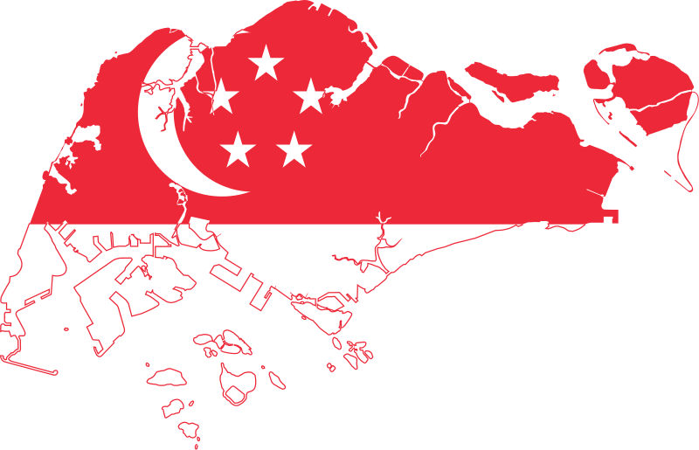
Singapore’s Exit from Malaysia 1965
After two years in Malaysia, strains began to occur between the government of the Federation and Singapore
Strains due to economic factors, competition between PAP and the Alliance, and clash in government philosophy
In July and October 1964, two race riots occurred in Singapore
Tension between Singapore and Kuala Lumpur regarding national budget in 1965
Finally, on 9 August 1965, Malaysia expelled Singapore from the Federation

